Slide 1
Dashboards
Stephan Kadauke
R/Medicine 2020

Slide 2
The Data Analysis Pipeline
From R for Data Science (https://r4ds.had.co.nz/introduction.html)
Notes:
We’ve already looked at static reports that are created when you knit a Rmd file.
But an important way in which clinical information is presented is not in static reports that need to be build manually, but instead…

Slide 3
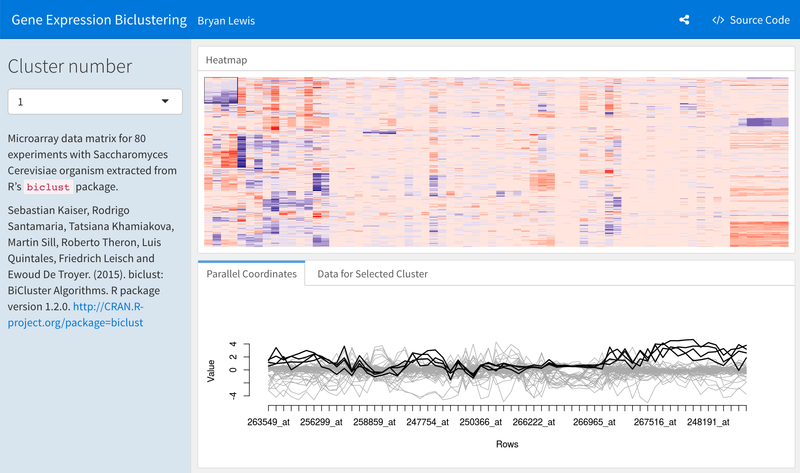
Dashboards visualize key data on demand
Notes:
Allows domain experts, who are often not trained in performing analytics, users to quickly find essential information to do their work.

Slide 4
Turn an R Markdown document into an interactive dashboard
Notes:
Here it comes in handy if you’ve coded you analysis reproducibly in R Markdown – because there’s flexdashboard, an R package that allows you to turn an R Markdown document into an interactive dashboard.

Slide 5
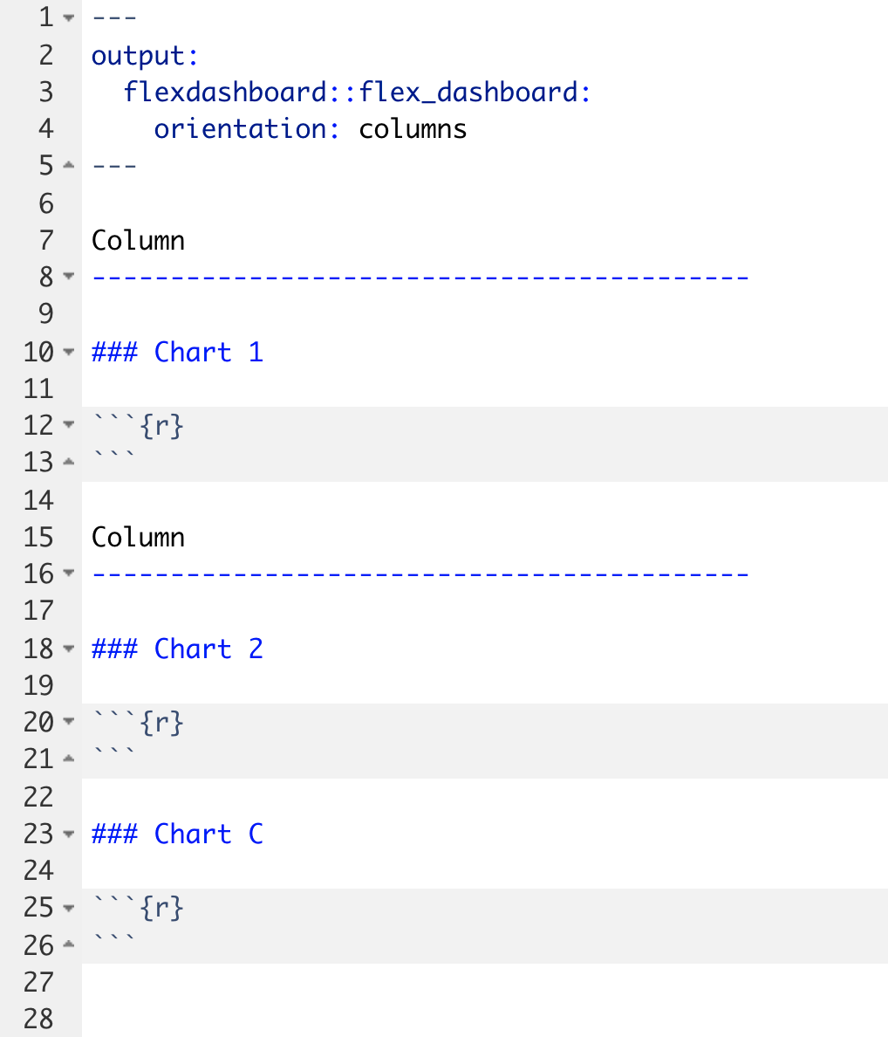

Slide 6
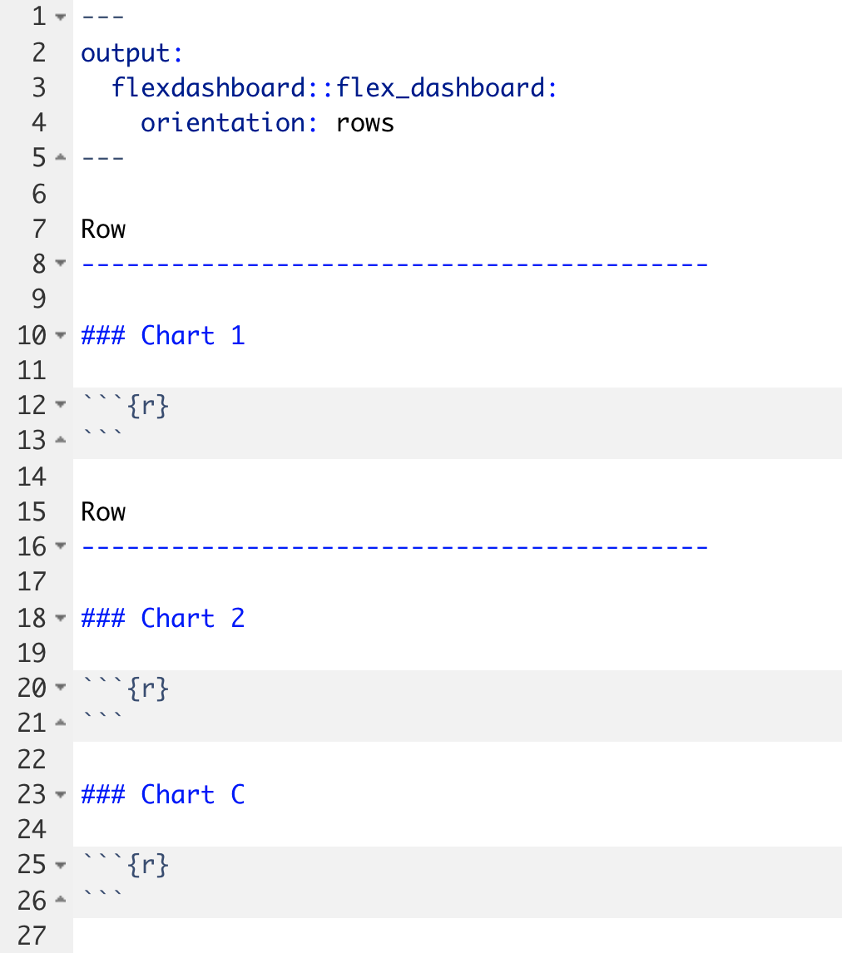

Slide 7
Your Turn #1
Open 04 – Dashboards.Rmd to work with a draft COVID19 flexdashboard. Do the following:
Knit the document to see what the dashboard looks like.
Change the Test Volumes Over Time plot so that it visualizes the fraction of positive tests on a given day. (Hint: map the fill aesthetic to result). Knit the document again and note the change.
Change the layout from columns to a row orientation. Knit the document again and note the change.
Click “yes” when you are finished!

Slide 8
Making plots interactive

Slide 9
Plotly makes ggplots interactive
ggplot(data = data_frame) +
geom_function(mapping = aes(mappings))
my_plot <- ggplot(data = data_frame) +
geom_function(mapping = aes(mappings))
ggplotly(my_plot)
Notes:
Step 1. Start with the ggplot template for making any kind of plot
** Step 2. Capture the ggplot in an object. For example, here I capture the plot as an object named “my_plot”
** Step 3. Write ggplotly(my_plot)

Slide 10
Your Turn #2
Return to 04 – Dashboard.Rmd.
Make the Test Volumes Over Time plot interactive.
Knit the document again to note the change. Hover over the interactive plots. Note what happens when you click on the various buttons that appear above the plot.
Click “yes” when you are finished.
Notes:
(Show how I can turn off invalid and negatives to just focus on positives!)

Slide 11
Interactive tables

Slide 12
DT makes data frames interactive
covid_testing
covid_testing %>%
datatable()
Notes:
Even easier.
Step 1. Start with the data frame you’d like to show
Step 2. Pipe it to the function datatable() which is part of the DT package.

Slide 13
Your Turn #2
Return to 04 – Dashboards.Rmd. Let’s try to display a list of positive results in the Details of Positive Test Results area of the plot.
Note that this area currently shows the contents of the covid_testing data frame but doesn’t actually filter for positive results. Add to the pipeline a filter() statement that selects only those rows where the result value is "positive" (Hint: "positive" must be in quotes). Knit the dashboard and note the change.
In order to use the datatable() function, we first need to load the DT package. Add a line to the setup chunk (all the way on top!) to load the DT package.
Now make the table interactive! Knit the dashboard and note the change.
Click “yes” when you are finished!

Slide 14
Add styling

Slide 15
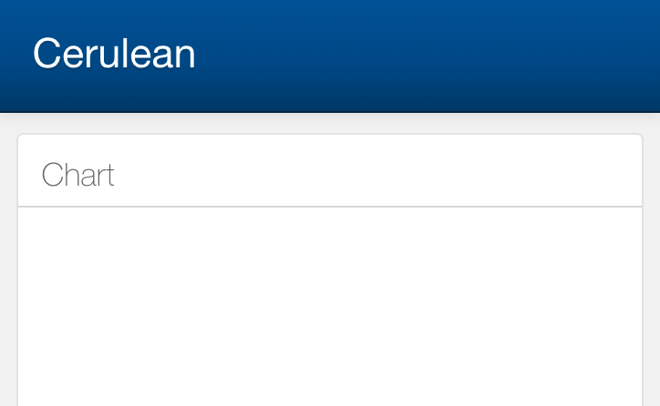
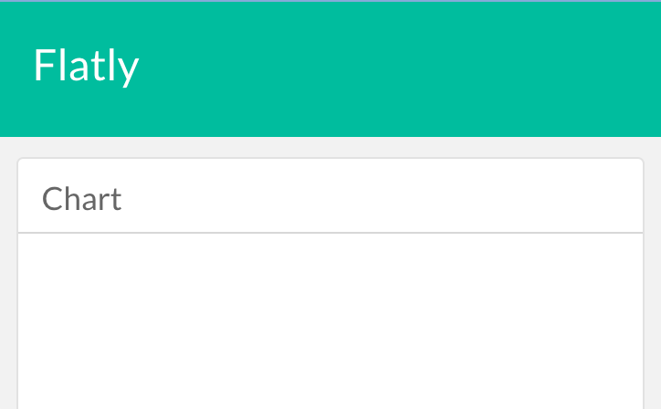
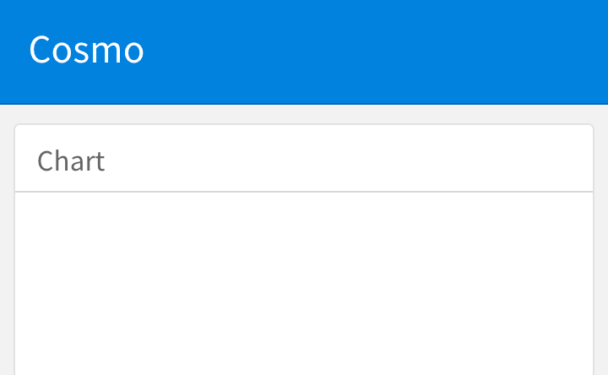
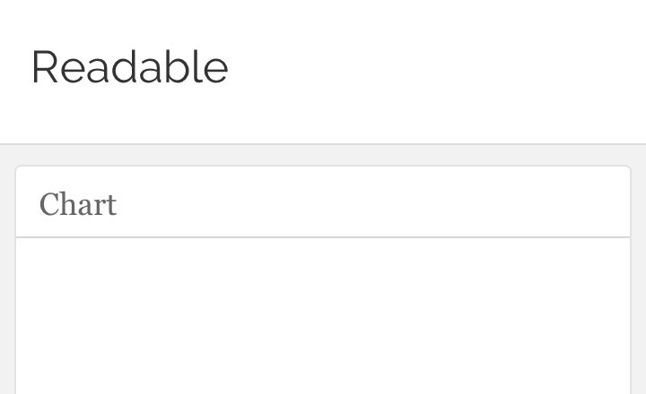
Notes:
Present themes
Many orgs have make their own CSS themes that conform to brand guidelines; can often find those and directly use in flexdashboard.

Slide 16
Adding a theme
---
title: "My Dashboard"
output:
flexdashboard::flex_dashboard:
orientation: rows
theme: cerulean
---
https://rmarkdown.rstudio.com/flexdashboard/using.html#themes

Slide 17
COVID19 Dashboard Hackathon!
Notes:
In this last exercise of the workshop, we will again send you into breakout rooms. Your TA will share their screen with the COVID19 flexdashboard source code open. The objective is to work as a team to tweak the dashboard using the tools we covered today. In 15 minutes we’ll bring everyone back and take a look at what each group has built!
Remember: your TA probably isn’t a flexdashboard expert, and there’s only going to be 15 minutes. But there are a couple of improvements you can make with the tools we’ve covered today, for example the style, or you might want to add another graph or table, or add a column to the table, or change the color theme of the graph, or tweak the axis labels to make them more descriptive. Have fun!

Slide 18
Recap
Turn R Markdown documents into interactive dashboards with flexdashboard
Turn ggplot objects into interactive plots with plotly
Turn data frames into interactive tables with DT

Slide 19
What else?

Slide 20
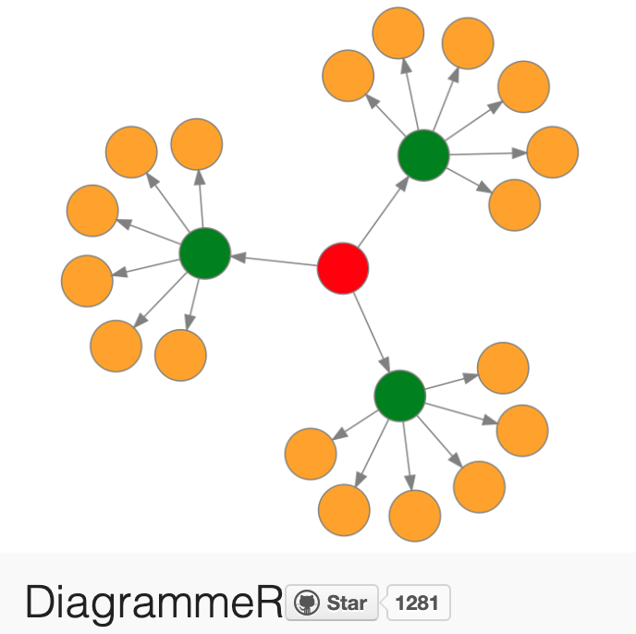
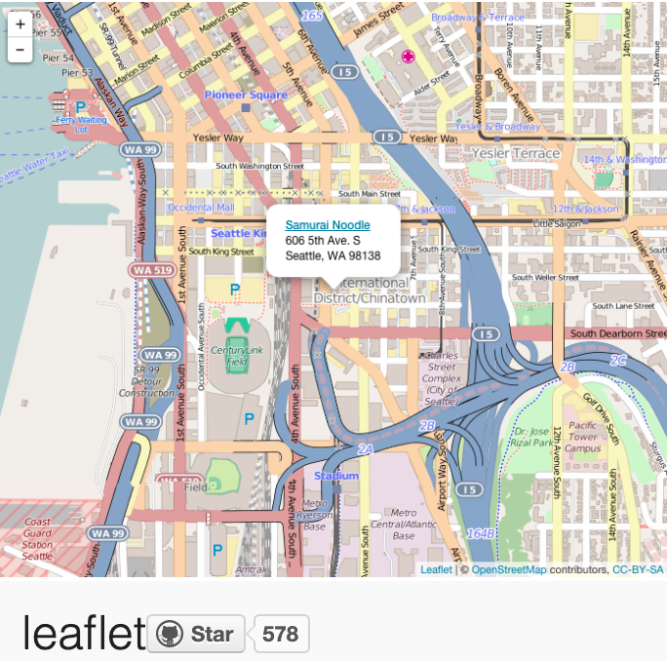
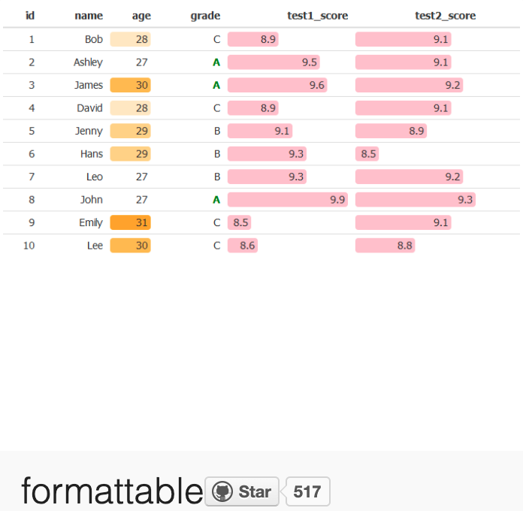
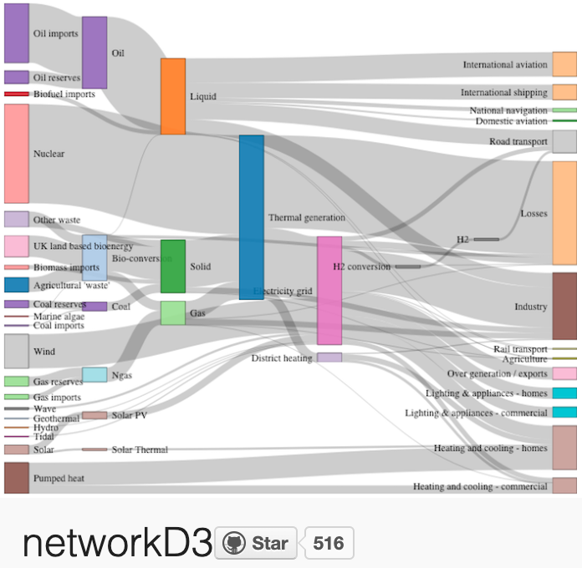
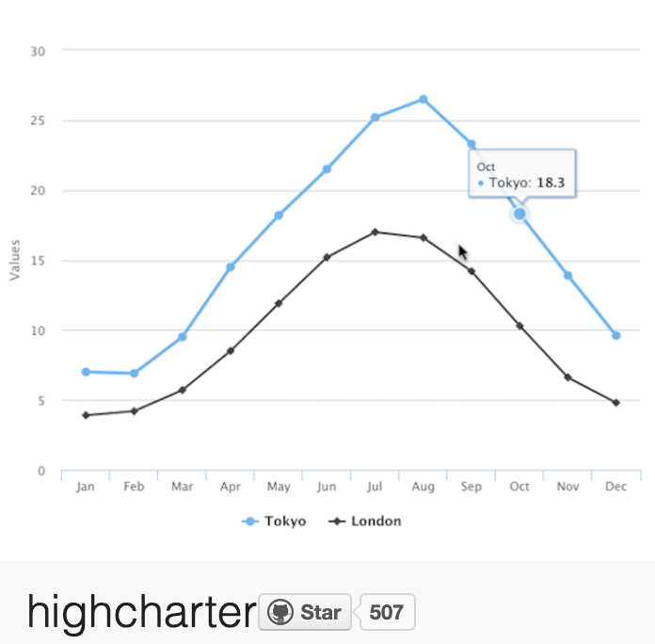
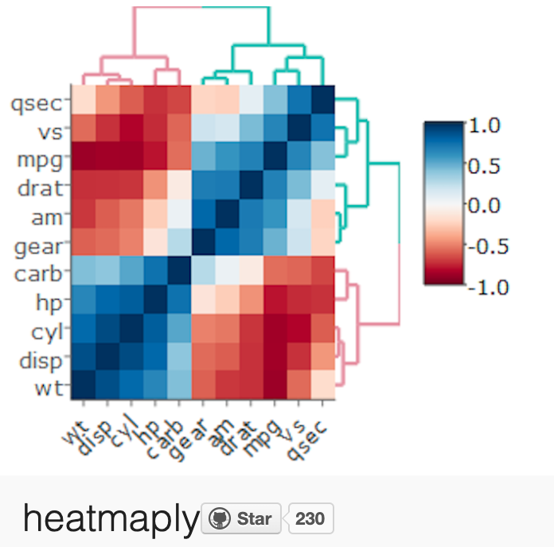
More interactive charts
https://gallery.htmlwidgets.org/

Slide 21
A framework for developing interactive web applications in R

Slide 22


Deploying dashboards and web apps
Shinyapps.io (free)
Shiny Server (free)
RStudio Connect ($)

Slide 23
What next?

Slide 24

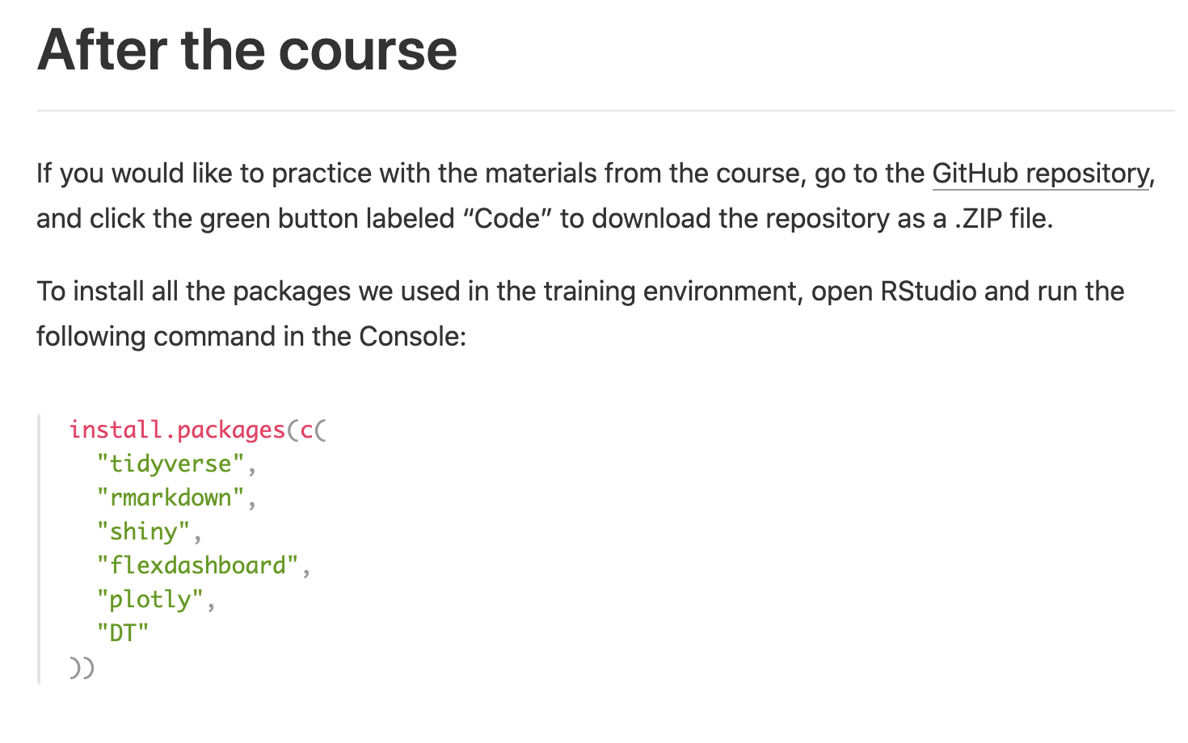
Install R and RStudio on your computer!
https://skadauke.github.io/rmed2020-101-site/

Slide 25
https://r4ds.had.co.nz
https://jrnold.github.io/r4ds-exercise-solutions/
Notes:
The “R For Data Science” book by Garrett Grolemund and Hadley Wickham has become the de-facto standard introduction to data science with R with best practice and ease of learning in mind. The entire text is available for free at this address. Each chapter has a lot of exercises,
** and there’s a solutions manual for the exercises online, which makes this great for self-paced learning.

Slide 26
https://bookdown.org/yihui/rmarkdown/

Slide 27

Notes:
See you all at R/Medicine tomorrow!

Slide 28

Thank You!
Daniella Mark
Mohamed El Fodil Ihaddaden
Silvia Canelon
Shelmith Kariuki
Sina Rüeger
Amit Kohli
Richard Hanna
Shannon Hagerty
Daniel Chen
Cass Wilkinson Saldaña
Peter Higgins
Bárbara Bitarello
Paul Wildenhain
Jake Riley
Martin Frigaard
Zach Dravis
Notes:
At this point, also in the name of my co-instructors, I would like to thank all the TAs
** So to give them a round of virtual applause please click the “yes” button one more time!

Slide 29
Thank You!
Notes:
And a big thank you to all of you R/Med 101 Participants!

Slide 30

Please complete the post-course survey!
https://bit.ly/rmed2020-101-post
Notes:
Leave this up

